Slide 1
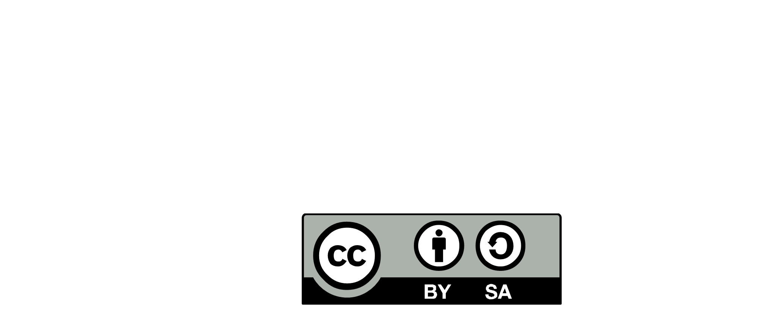
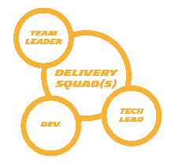
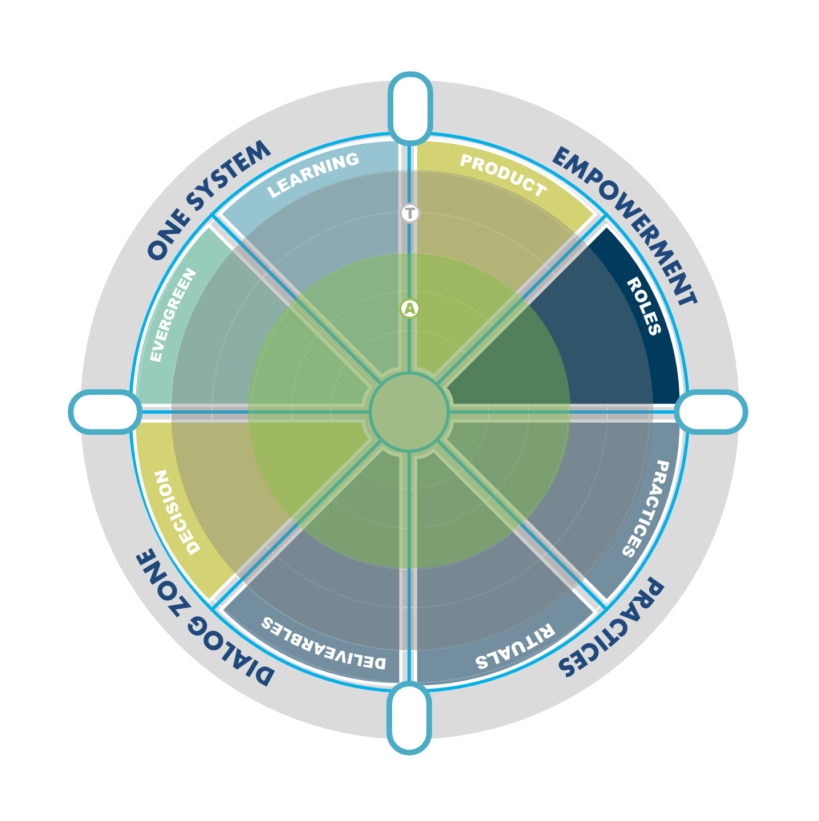







CONTINUOUS ARCHITECTURE – AUTONOMY ASSESMENT
SQUAD
Product/team Characteristics
Main architecture Stakes
TEAMS READINESS FOR AUTONOMY
T
TARGET
ARCHITECTURE FOCUS
(12-18 MONTHS)
A
ADOPTED
ARCHITECTURE RISK
xx
5
* 12 à 18 mois
4
2
FULL STACK & PRODUCT
ARCHITECTS EMBEDDED
3
MANDATORY
EA STEERING REVIEW
CUSTOMISATION
xx
6
9
11
WORKDAY,…
TECH UNDERSTANDING & DECISION
SQUAD 2
On boarding /carrer /.. Intouch
Très business
7
11
12
13
PRODUCT UNDERSATNDING & DECISION
Customisation à gérer/maitriser
DE
18
TECH
DECISION
RECOLTASP
Core Intouch processes
Paramétrage des Business Processes (low code)
Très business
Fédération identité
19
39
Customisation à gérer/maitriser
32
TECH
DECISION
29
23
TECH
DECISION
30
26
24
HR APPS FBN
Nombreuses applications « make » + GTA /SRK progiciel
Périmètre restreint (FR)
Risques sécurité et obso technos
Aide « trade off » Valeur/pérennité
Risque « Zone de confort » techno
PSI
Flux d’intégration Intouch
Intégration de société
Exposition API
TEAM AUTONOMY
(COLLECTIVE UNDERSTANDING AND DECISION CAPABILTIES)
Exposition API (HCMFLIX)
OODRIVE decomV
Hosting SRK (obso / custo)
Décommissionnement Mainframe
1. Product boundaries defined
PRODUCT
DECISONNT
A
PRODUCT
DECISON
ADOPT
33. Architect decision in gitlab
44. Guide and develop Team competences
DIGITAL EMPLOYEE
Factory 365° (plateforme support pour autres équipes)
Portfolio applicatif « make/buy »
Risque sécurité (sur legacy)
Finaliser la runway d’architecture
Faire vivre les documents d’archi (forte inno)
3. Define integration strategy
PRODUCT
DECISONNT
TECH
DECISION
T
TAERGET
23. Tech radar
PRODUCT
DECISONNT
26. Operability by design KEYSTONE
1
TEAM AUTONMY
FONCTIONNAL
AUTONOMY
TECHNICAL
AUTONOMY
SQUAD 1
SQUAD 2
SQUAD 5
SQUAD 4
SQUAD 3
SQUAD 6
SQUAD 7

Slide 2
CONTINUOUS ARCHITECTURE – AUTONOMY ASSESMENT
SQUAD
Product/team Characteristics
Main architecture Stakes
TEAMS READINESS FOR AUTONOMY
ARCHITECTURE FOCUS
(12-18 MONTHS)
ARCHITECTURE RISK
T
TARGET
* 12 à 18 mois
ADOPTED
A
2
FULL STACK & PRODUCT
ARCHITECTS EMBEDDED
3
MANDATORY
EA STEERING REVIEW
TECH UNDERSTANDING & DECISION
PRODUCT UNDERSATNDING & DECISION
TEAM AUTONOMY
(COLLECTIVE UNDERSTANDING AND DECISION CAPABILTIES)
ADOPT
A
TAERGE
T
1
TEAM AUTONMY
FONCTIONNAL
AUTONOMY
TECHNICAL
AUTONOMY

